Slide 1
Obedience of Sunnah of the Holy Prophet (صلى الله عليه و سلم)
Presented By:
Moiz Ansari
Ahmed Irfan
Zain Javed

Slide 2
Table of Contents
01
02
03
04
Introduction
Definition
Types of Sunnah
Importance of obedience
05
Conclusion

Slide 3
01
Introduction
An introduction to the importance of obedience of the Holy Prophet Hazrat Muhammad (صلى الله عليه و سلم)
Notes:
AOA. I am Moiz Ansari and I am here along with my teammates, Ahmed Irfan and Zain Javed. We are here to shed some light on the topic Obedience of Sunnah of the Prophet Muhammad S.A.W.

Slide 4
Introduction
Sunnah stands as a beacon, the path set by Prophet Muhammad (صلى الله عليه و سلم) Obedience to the sunnah, an expression of love to Allah. Spending our lives as muslims with the teachings of the Prophet (صلى الله عليه و سلم).
Notes:
Hazrat Muhammad (PBUH) ne apni sunnat se jo zindagi guzarne ka rasta dikhaya wo hamare liye mash`ale rah hai… AAP (SAW) ki sunnat ke amal karne se aur un ki di hui taaleemat ke mutabik zindagi guzarne se allah se muhabbat ka zariya banta hai.

Slide 5
Introduction
Role Model: Prophet Muhammad (صلى الله عليه و سلم) is considered the perfect example for Muslims
Preservation of Revelation: The Sunnah complements and elaborates on the Quranic verses.
Unity of the Ummah: Obedience to the Sunnah unifies the Muslim community.
Notes:
Role Model: Prophet Muhammad (PBUH) is considered the perfect example for Muslims
Ayat: “Beshak Hazrat Muhammad (SAW) ki zindagi hamare liye behtereen namoona hai.”
Preservation of Revelation: The Sunnah complements and elaborates on the Quranic verses, providing practical examples and context for the implementation of divine guidance.
Unity of the Ummah: Obedience to the Sunnah unifies the Muslim community by establishing a common set of practices and beliefs.

Slide 6
02
Definition
What is Sunnah?

Slide 7
Definition
The sunnah reflects and encompasis the actions, sayings and approvals of Prophet Muhammad (صلى الله عليه و سلم). It is practical manifestation of the Quran and guidelines to the Muslims. Obedience of sunnah is conscious effort to spend our lives with the teachings of Prophet.

Slide 8
03
Types of Sunnah
There are three types of Sunnah

Slide 9
Types of Sunnah
Sunnah al Qawliyyah
Sunnah al Failiyyah
The words of Prophet Muhammad (صلى الله عليه و سلم)
Actions of Prophet Muhammad (صلى الله عليه و سلم)
Notes:
Sunnah al Qawliyyah

Slide 10
Sunnah al Taqririyah
The approvals of Prophet Muhammad (صلى الله عليه و سلم) regarding the actions of the Companions which occurred in two different ways:
When Prophet Muhammad (صلى الله عليه و سلم) kept silent for an action that took place in his presence and he did not oppose it, this showing his silent approval.
When Prophet Muhammad (صلى الله عليه و سلم) showed his pleasure and smiled at a companion’s action, showing his approval.

Slide 11
04
Importance of Obedience of Sunnah

Slide 12
Religious Practices and Rituals
Ways to deliver religious rituals including namaz, fasting and hajj.
Connection With Allah
“He who obeys the Messenger has indeed obeyed Allah”.
[al-Nisaa’4:80]

Slide 13
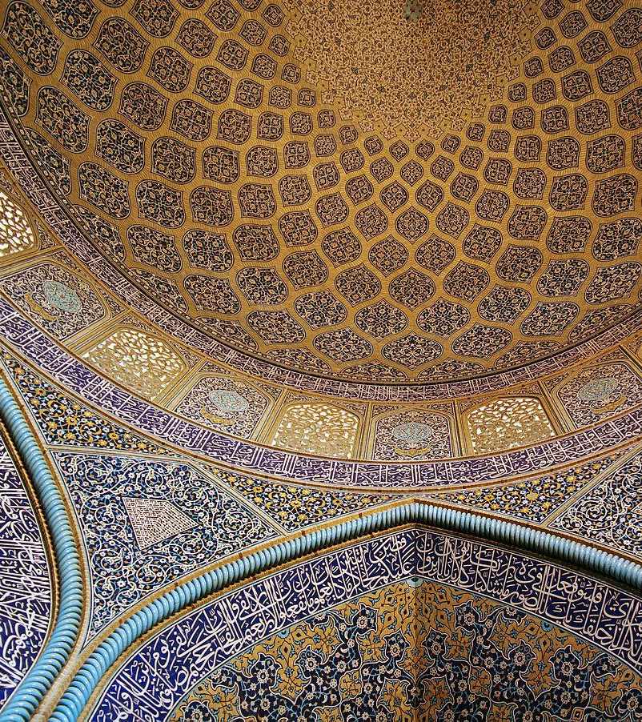
Legal and Juridical Framework:
Abu Huraira reported: The Prophet Muhammad (ﷺ) said,
"Verily, those before you were destroyed because they punished the poor and forgave the rich."
(Bukhari and Muslim)
Notes:
BEFORE ISLAM
DURING
SLAVES – ORIGIN – STATUS
LAGALITY

Slide 14
Social & Family Relations
Abdullah bin Amr reported: The Messenger of Allah (ﷺ) said,
"The best of you is the best to his family, and I am the best among you to my family."
(Tirmidhi)

Slide 15

Moral and Ethical Conduct
Abu Huraira reported: The Prophet Muhammad (ﷺ) said,
"The strong are not the best wrestlers. Verily, the strong are only those who control themselves when they are angry."
(Sahih al-Bukhari)

Slide 16
Unity of the Muslim Ummah
The Prophet Muhammad (ﷺ) said:
"The example of the believers in their affection, mercy, and compassion for each other is that of a body. When any limb aches, the whole body reacts with sleeplessness and fever."
(Bukhari and Muslim)
Guidance in Daily Life:
Perfect Guidance in all affairs of life like :
Leader
Ruler
Administrator
Economist
Father
Husband
Jurist

Slide 17
Sahih Al-Bukhari 7137
The Prophet Muhammad (ﷺ) said:
“Whoever obeys me, obeys Allah, and whoever disobeys me, disobeys Allah.”

Slide 18
05
Conclusion
Obedience of sunnah is not a rigid set of rules but a dynamic way of life.
As we conclude, let's reflect on the transformative power of aligning our lives with the teachings of the Prophet (صلى الله عليه و سلم).

Slide 19
Jazak Allah
Any Questions!

Slide 20


